Slide 1






Inflammatory Bowl Disease
Everything You Need To Know
Created & Presented By -
Makes You Eat by Dt. Foram Modi, Mumbai
Visit - https://makesyoueat.com/
Dietitian Foram Modi
Best Dietitian in Mumbai

Slide 2


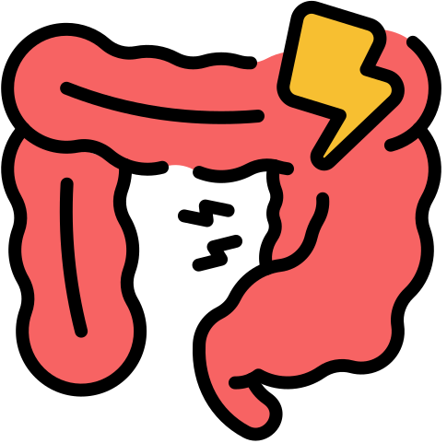
What is Inflammatory Bowel Disease?
Understanding the Basics of IBD
Inflammatory Bowel Disease (IBD) is a group of chronic conditions that cause inflammation in the gastrointestinal (GI) tract.
It’s different from common digestive issues like gas or bloating, and needs medical diagnosis and long-term care
  Chronic inflammation of the digestive tract
  Two main types: Crohn’s disease and ulcerative colitis
  Can affect quality of life and overall health

Slide 3


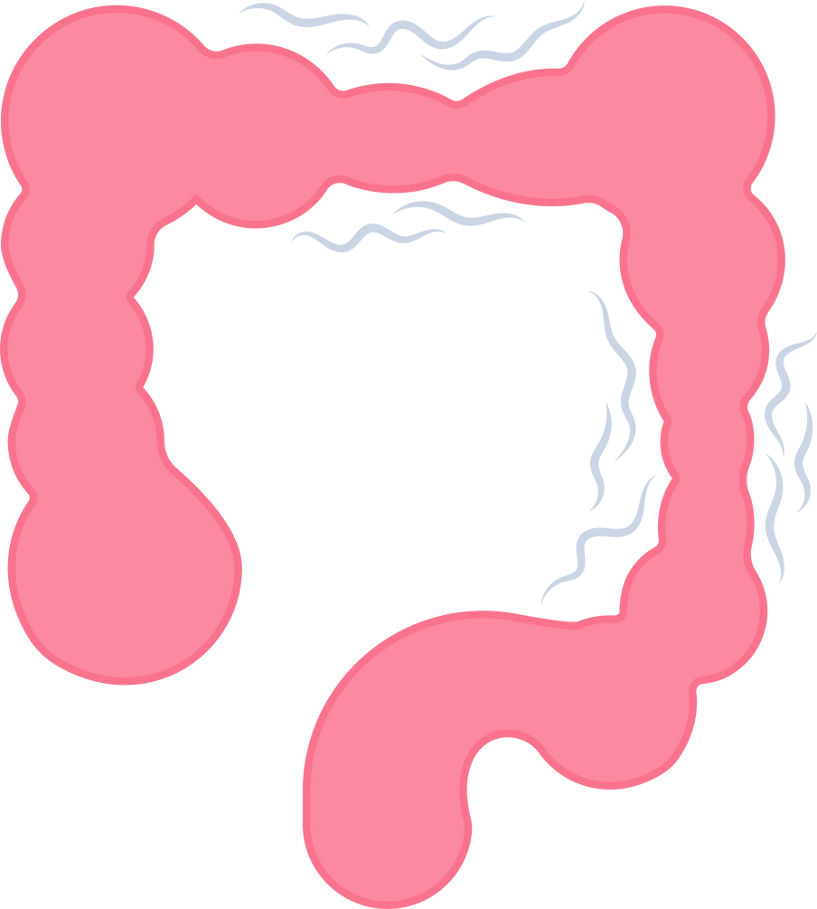
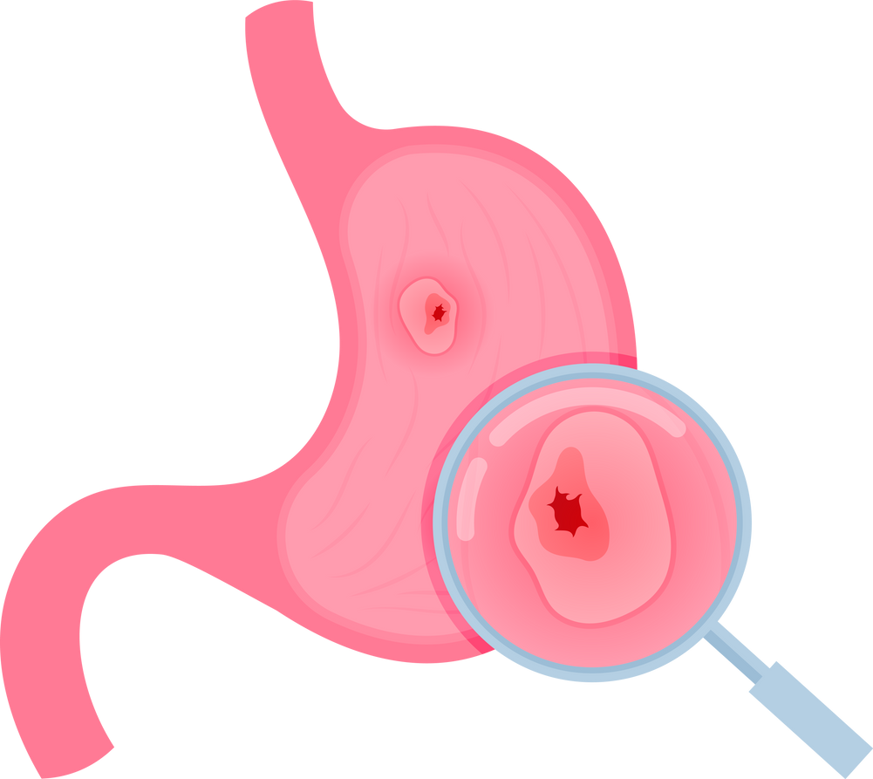



Types of Inflammatory Bowel Disease
Crohn’s Disease
Ulcerative Colitis
Can affect any part of the GI tract
Affects only the colon and rectum
The two major types of IBD are Crohn’s disease, which can impact any section from mouth to anus, and ulcerative colitis, which targets the large intestine.
Each has distinct symptoms and treatment pathways

Slide 4




Inflammatory Bowel Disease Causes
While the exact cause is unknown, IBD is believed to result from a combination of genetic predisposition, immune system dysfunction, and environmental triggers such as diet, stress, and antibiotic use.
What Triggers IBD?
Genetics and family history.
Immune system response
Environmental and lifestyle factors

Slide 5
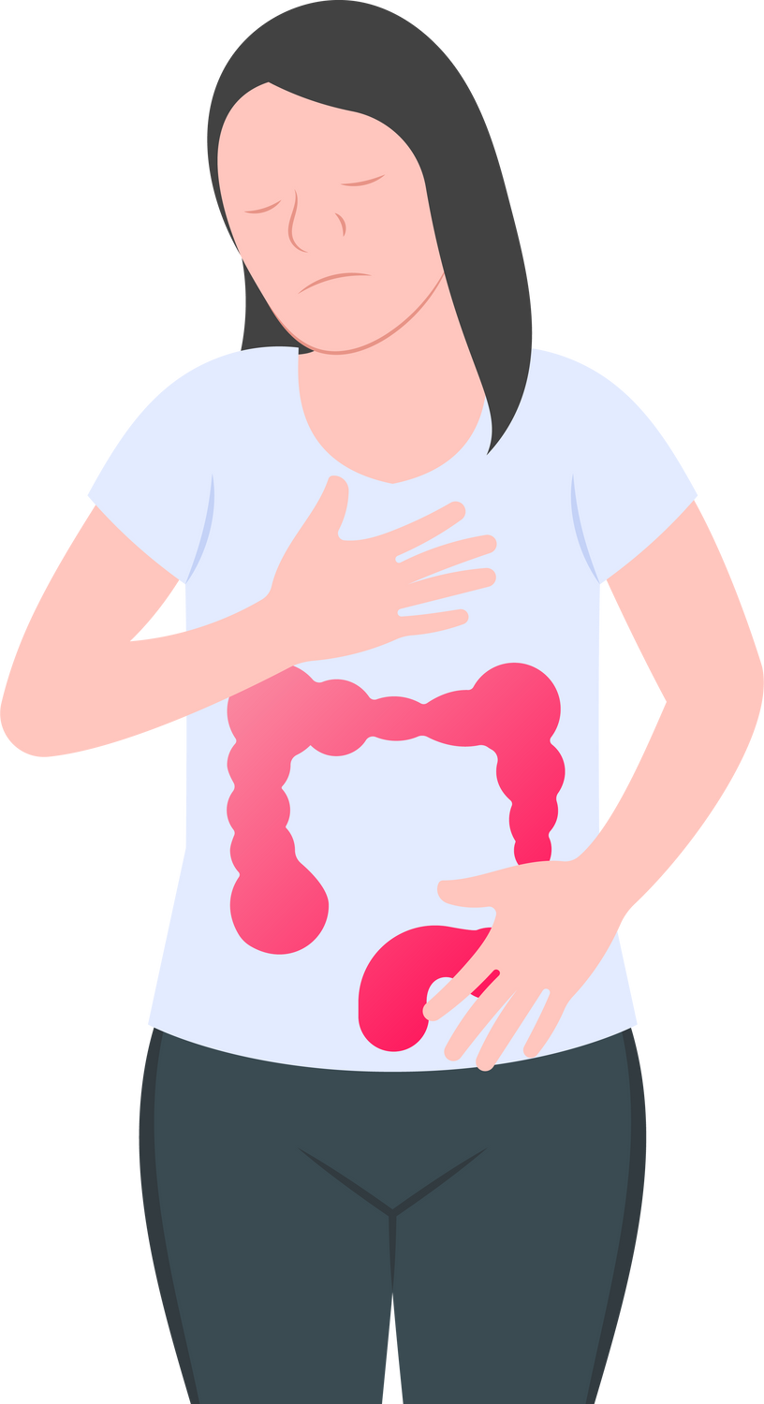
Pathogenesis of Inflammatory Bowel Disease
  Abnormal immune response to gut bacteria
  Chronic inflammation in the intestinal lining
  Disrupted gut barrier function
The pathogenesis of inflammatory bowel disease involves a complex interplay of immune responses and microbial imbalances in the gut, leading to persistent inflammation and tissue damage

Slide 6



Inflammatory Bowel Syndrome
  Irritable Bowel Syndrome (IBS) is functional, not inflammatory
  IBS does not cause permanent damage to the GI tract
  IBS symptoms: bloating, cramping, diarrhea or constipation
IBS is often confused with IBD but differs significantly. IBS involves digestive discomfort without inflammation or damage, while IBD includes chronic inflammation and structural changes in the intestine

Slide 7
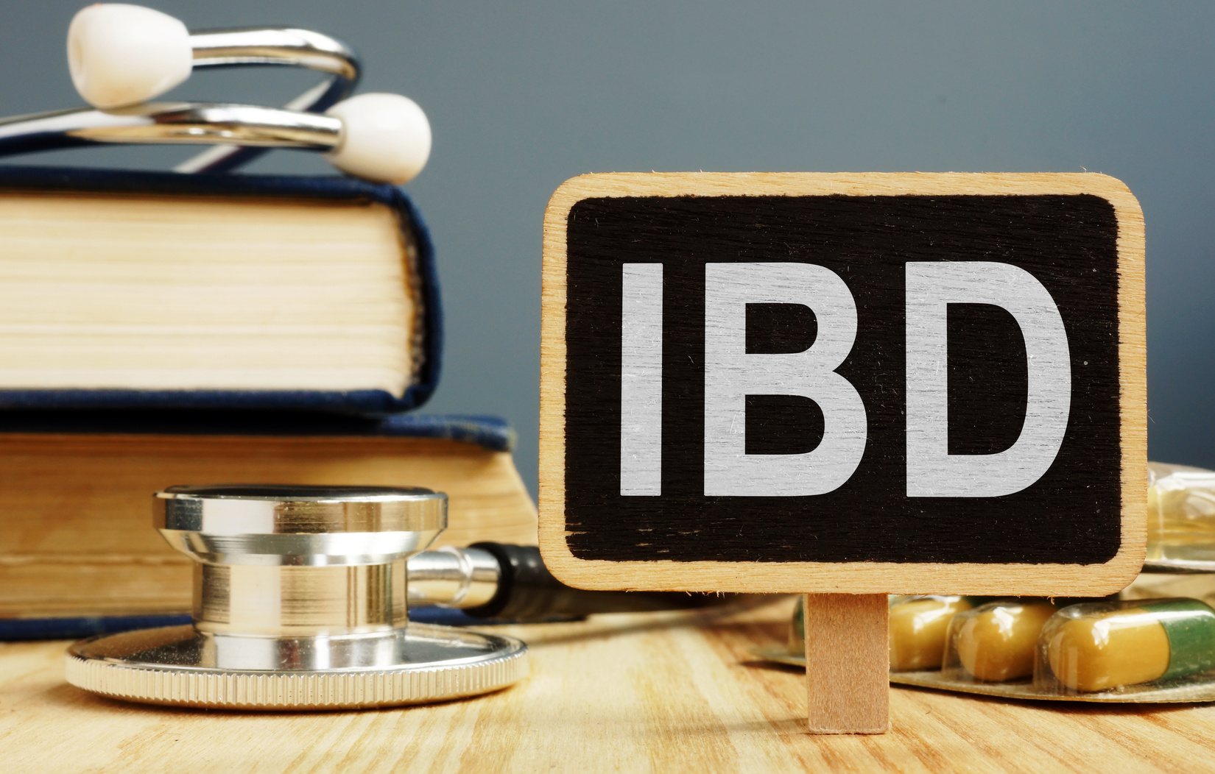
Irritable Bowel Syndrome vs Inflammatory Bowel Disease
  IBD: structural damage, visible on imaging
  IBS: no inflammation, often triggered by stress or food
  IBD requires medication; IBS may be managed with lifestyle changes
Understanding the differences between IBD and IBS is critical for proper diagnosis and treatment. While symptoms may overlap, their underlying causes and treatment plans are very different.

Slide 8

Inflammatory Bowel Disease and Arthritis
The Gut-Joint Connection
  IBD may lead to extraintestinal symptoms like joint pain
  Arthritis is the most common complication outside the gut
  May need combined treatment for both conditions
IBD is often linked to joint inflammation, with arthritis being a common issue. Anti-inflammatory treatment plans may help manage both gut and joint symptoms in affected individuals.

Slide 9

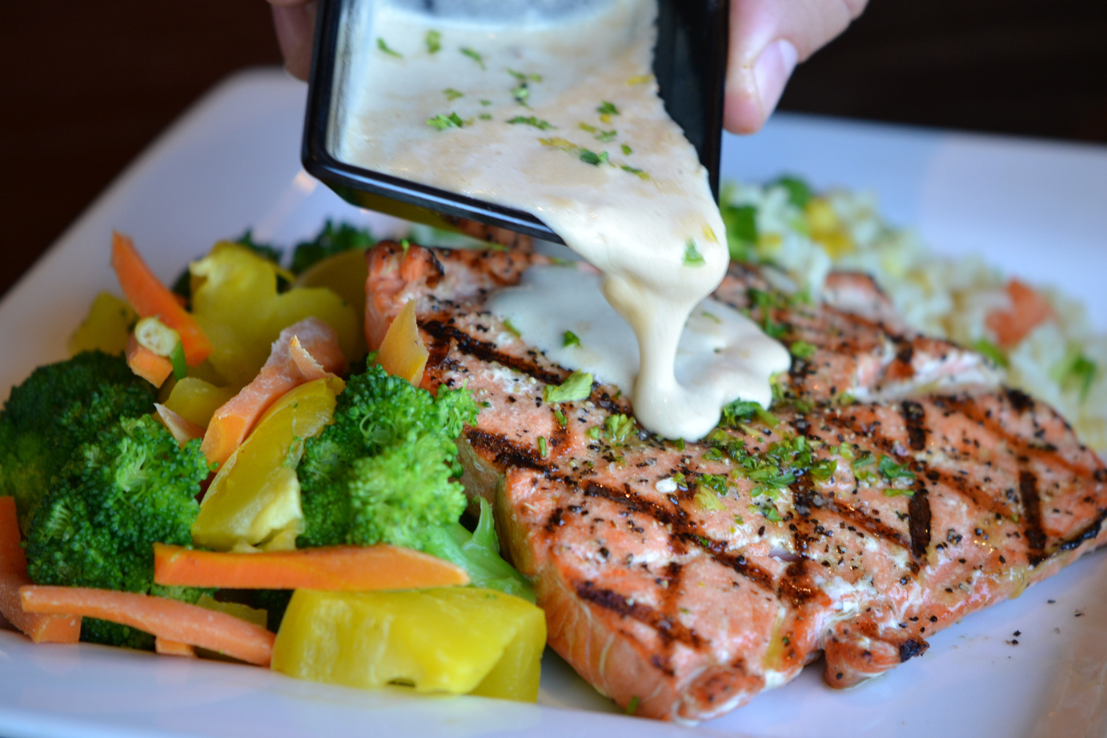


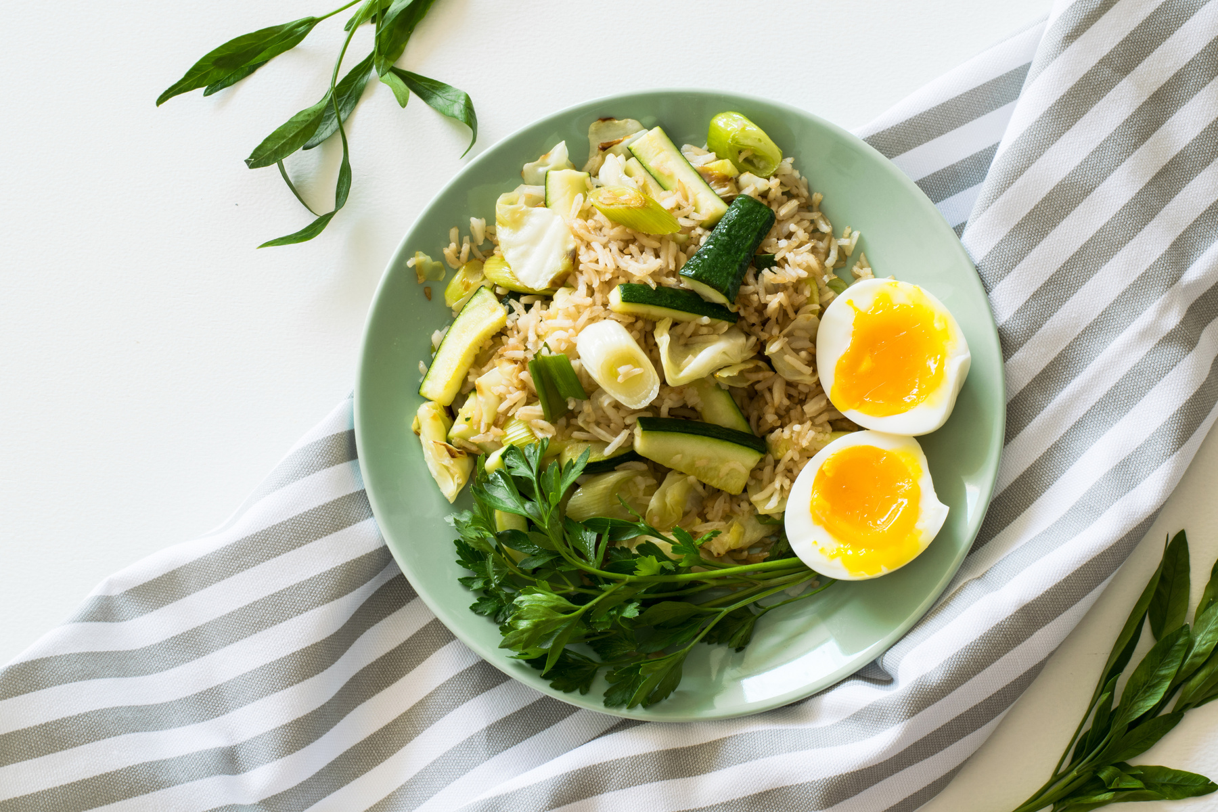
01
02
Inflammatory Bowel Disease Diet
Diet plays a vital role in managing IBD flare-ups. A gentle, balanced approach to eating can reduce symptoms and prevent complications. Consulting a dietitian is highly recommended.
03
  Focus on low-residue, easy-to-digest foods
  Avoid dairy, spicy, and fatty foods
  Hydration and portion control are key

Slide 10
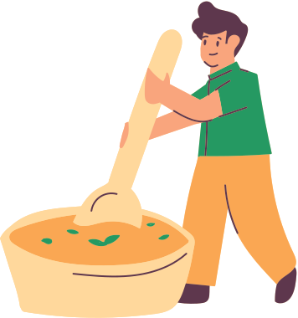
Anti Inflammatory Diet Plan Indian
  Include turmeric, ginger, flaxseeds, leafy greens
  Indian staples: moong dal, rice, khichdi, sabudana
  Stay away from fried, processed, and spicy foods
An anti-inflammatory diet in Mumbai or other Indian cities can be adapted using local foods. Opt for gut-soothing, non-irritating meals to ease IBD symptoms and support recovery.

Slide 11
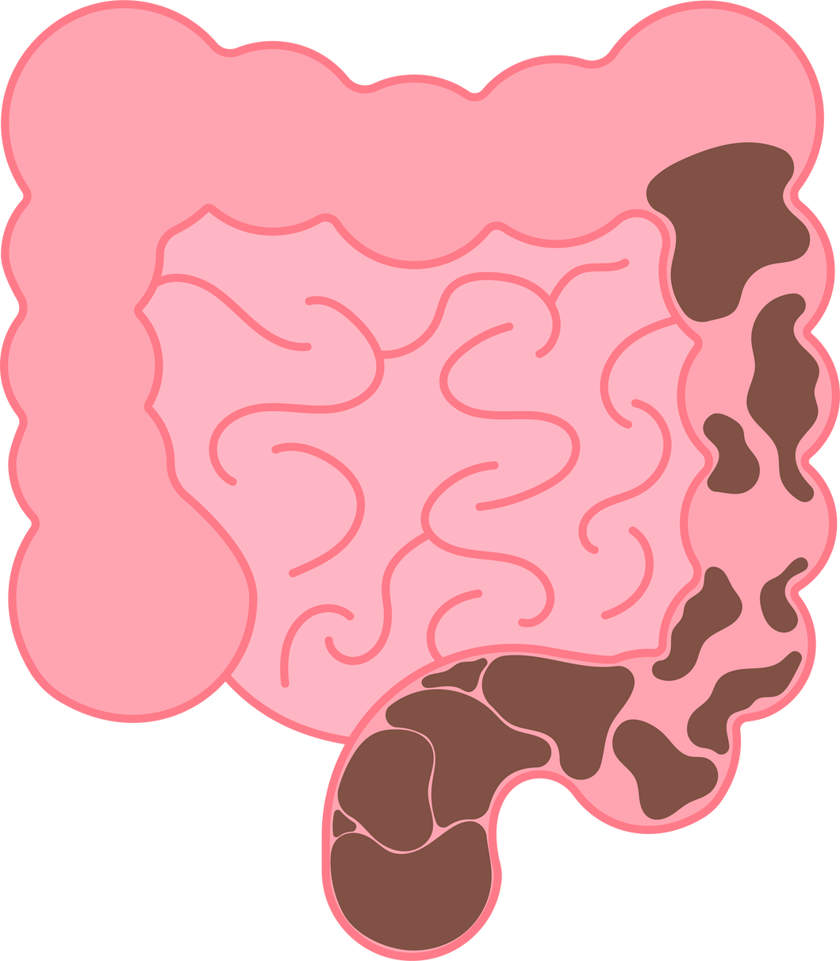
Anti Inflammatory Foods
  Omega-3-rich foods: walnuts, flaxseeds
  Spices: turmeric, cinnamon
  Vegetables: spinach, broccoli, beetroot
Adding anti-inflammatory foods into your daily meals can naturally ease inflammation. These foods support gut healing and can be integrated into any Indian diet plan for long-term benefits

Slide 12
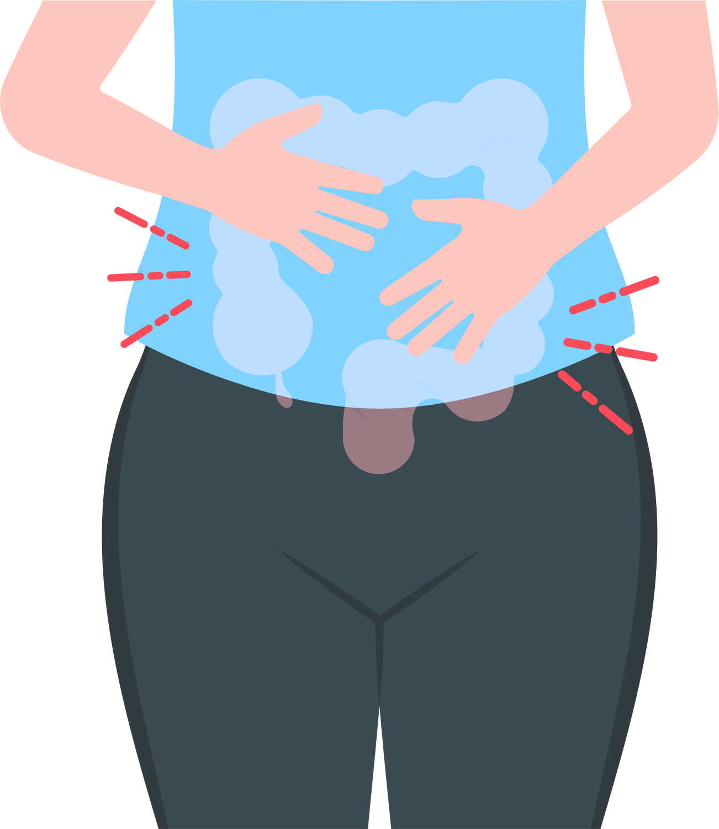
Inflammatory Bowel Disease Treatment
  Medications: steroids, immunosuppressants, biologics
  Anti-inflammatory diet and lifestyle changes
  Surgery in severe or unresponsive cases
IBD treatment requires a combination of medication and personalized dietary strategies.
Following an anti-inflammatory diet chart and staying consistent with medical care can control the disease effectively.

Slide 13

About Dt. Foram Modi
  Expert in therapeutic and clinical diets
  Over 12+ years of experience with diverse conditions
  Focus on personalized, practical meal planning
  Regular speaker and educator in nutrition workshops
Checkout Her Anti Inflammatory Diet Plan in Mumbai -
https://makesyoueat.com/dietitian-in-mumbai/anti-inflammatory-diet/

Slide 14




THANK YOU
Take care of your family's health
Created & Presented By -
Makes You Eat by Dt. Foram Modi, Mumbai
Visit - https://makesyoueat.com/
Dietitian Foram Modi
Best Dietitian in Mumbai

